Slide 1
Ontology Views
Jie Zheng, Zuoshuang(Allen) Xiang, Yongqun (Oliver) He, and Chris J. Stoeckert

Slide 2
Reference Ontologies
Developed collaboratively
Multiple communities working together
Generally very large and highly detailed
GO contains over 30,000 terms, many details in annotation of gene and gene products
Different applications may use only portions of the reference ontology, based on needs

Slide 3
OBI
Over 20 different communities involved in OBI development
Each community/application frequently uses a subset of OBI terms
Each community may have its own preferred labels

Slide 4
Ontology View
What’s an ontology view?
a subset of the whole ontology or tagged subset of terms in the whole ontology to meet users’ specific need
contains user preferred labels where needed

Slide 5
Existing Implementation
GO-Slim: cut-down versions of the GO
a subset of GO
contains only high level terms
(http://www.geneontology.org/GO.slims.shtml)
Washington: ontology views project
Generate application ontologies by getting subsets of reference ontologies; also provide mapping
(http://sig.biostr.washington.edu/projects/ontviews/)
Missing: user preferred labels

Slide 6
Our approach: annotation property
Annotation property
Tag the terms interesting to a specific community and/or application
Provide user preferred labels
Example usage of annotation property in OBI:
FGED alternative term
IEDB alternative term
As subclass of ‘alternative term’

Slide 7
Our Ontology View Architecture
obi.owl
obi_FGED.owl
<?xml version="1.0"?>
<rdf:RDF xmlns="http://purl.obolibrary.org/obo/obi.owl#"
xml:base="http://purl.obolibrary.org/obo/obi.owl"
xmlns:ro="http://www.obofoundry.org/ro/ro.owl#"
xmlns:p3=http://purl.obolibrary.org/obo/iao/dev/iao-main.owl#
xmlns:snap=http://www.ifomis.org/bfo/1.1/snap#
xmlns:bfo=http://www.ifomis.org/bfo/1.1#
xmlns:rdf=http://www.w3.org/1999/02/22-rdf-syntax-ns#
xmlns:owl=http://www.w3.org/2002/07/owl#
……
xmlns:span="http://www.ifomis.org/bfo/1.1/span#">
<owl:Ontology rdf:about=http://purl.obolibrary.org/obo/obi.owl>
…….
<?xml version="1.0"?>
<rdf:RDF xmlns="http://purl.obolibrary.org/obo/obi.owl#"
xml:base="http://purl.obolibrary.org/obo/obi.owl"
xmlns:ro="http://www.obofoundry.org/ro/ro.owl#"
xmlns:p3=http://purl.obolibrary.org/obo/iao/dev/iao-main.owl#
xmlns:snap=http://www.ifomis.org/bfo/1.1/snap#
xmlns:bfo=http://www.ifomis.org/bfo/1.1#
xmlns:rdf=http://www.w3.org/1999/02/22-rdf-syntax-ns#
xmlns:owl=http://www.w3.org/2002/07/owl#
……
xmlns:span="http://www.ifomis.org/bfo/1.1/span#">
<owl:Ontology rdf:about=http://purl.obolibrary.org/obo/obi_FGED.owl>
…….
source ontology
1
subset of
source ontology
2
view annotation layer
1
imports
2
=
4
ontology view
view_annot.owl
<rdf:Description rdf:about="http://purl.org/obo/owl/NCBITaxon#NCBITaxon_8360">
<obo:OBI_9991119 xml:lang="en">Xenopodinae</obo:OBI_9991119>
</rdf:Description>
<rdf:Description rdf:about="http://purl.obolibrary.org/obo/OBI_0000879">
<obo:OBI_9991119 xml:lang="en">random primed DNA labeling</obo:OBI_9991119>
</rdf:Description>
……
<?xml version="1.0"?>
<rdf:RDF xmlns="http://purl.obolibrary.org/obo/obi.owl#"
xml:base="http://purl.obolibrary.org/obo/obi.owl"
xmlns:ro="http://www.obofoundry.org/ro/ro.owl#"
xmlns:p3=http://purl.obolibrary.org/obo/iao/dev/iao-main.owl#
xmlns:snap=http://www.ifomis.org/bfo/1.1/snap#
xmlns:bfo=http://www.ifomis.org/bfo/1.1#
xmlns:rdf=http://www.w3.org/1999/02/22-rdf-syntax-ns#
xmlns:owl=http://www.w3.org/2002/07/owl#
……
xmlns:span="http://www.ifomis.org/bfo/1.1/span#">
<owl:Ontology rdf:about=http://purl.obolibrary.org/obo/obi_FGED.owl>
<owl:imports rdf:resource="http://purl.obolibrary.org/obo/obi/view_annot.owl"/>
……
3
view annotation property
defined in or
1
2
<owl:AnnotationProperty rdf:about="http://purl.obolibrary.org/obo/OBI_9991119">
<rdfs:label rdf:datatype="http://www.w3.org/2001/XMLSchema#string">FGED alternative term</rdfs:label>
<obo:IAO_0000115 rdf:datatype="http://www.w3.org/2001/XMLSchema#string">An alternative term used by the Functional Genomics Data (FGED) Society.</obo:IAO_0000115>
<rdfs:subPropertyOf rdf:resource="http://purl.obolibrary.org/obo/IAO_0000118"/>
</owl:AnnotationProperty>
Advantage: add separate view annotation layer to source or subset of source ontology
- provide flexibility

Slide 8
Implementations
Tag terms using view-specific annotation property
Option 1: Add annotation property to the view-specific terms in the view annotation layer, e.g., annot_view.owl, manually
Option 2: Mark the view-specific terms in a tab delimited file, and create the view annotation layer, e.g., annot_view.owl, automatically
Ontology views
Option1: Extract the subset of source ontology including view-specific terms and their related terms and axiom and import the view annotation owl file
Option2: import the view annotation owl file to the whole source ontology directly

Slide 9
Ontodog
One implementation of generation of ontology view automatically
Web application tool, no installation and minimal ontology knowledge required
Provide templates to tag the ontology view terms in a tab delimited file
Extract any subset of a source ontology
Generate view annotation owl file

Slide 10
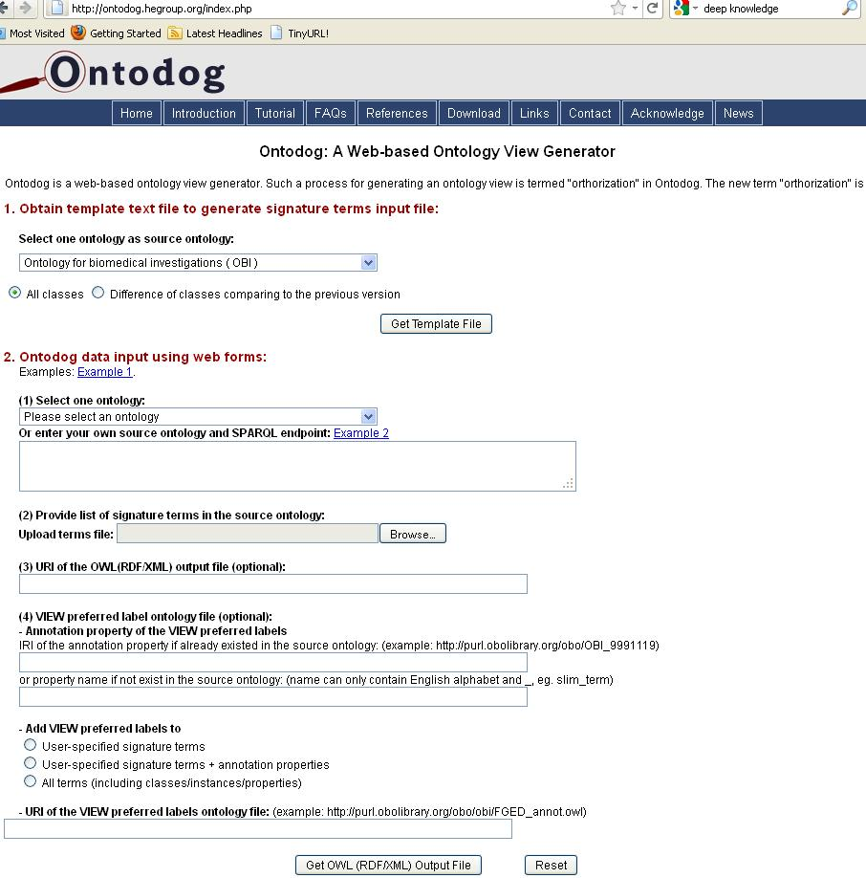
Template signature terms file:
A list of classes in a source ontology with required information to generate the view.
source ontology
signature terms file
URI of subset of
source ontology
view annotation layer
view annotation property
- existing
- not existing
view annotation
options
URI of view annotation
layer ontology
http://ontodog.hegroup.org

Slide 11
Signature terms file
Signature terms: the terms in a source ontology and would like to be included in the view for an application/community
Signature terms file: a tab delimited file listing all classes (IRIs and labels) in a source ontology and the signature terms are marked using ‘x’ or ‘X’ in the ‘Community View Tag column’ with user preferred label where needed.

Slide 12
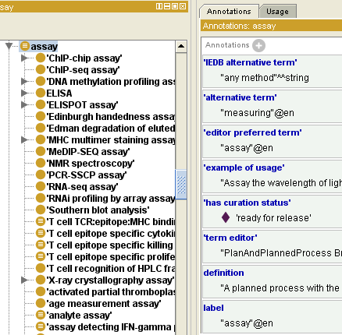
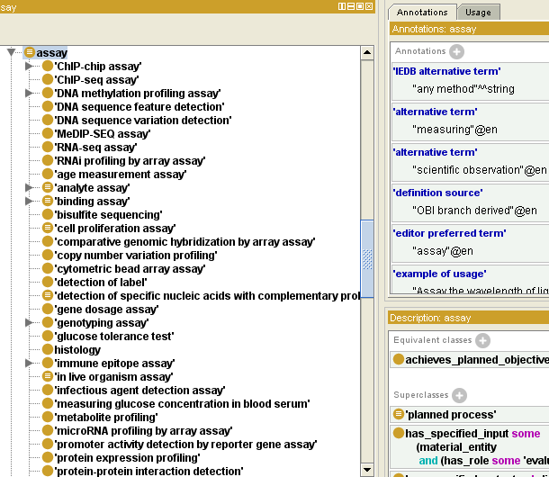
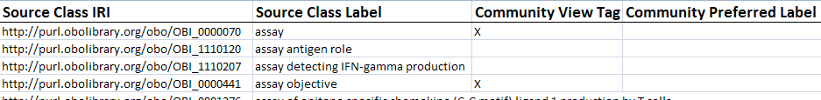
Ontodog
obi.owl
source ontology
Ontology Upload
RDF store
(obi.owl)
SPARQL
queries
Ontodog
signature terms file
obi_FGED.owl
subset of source ontology
<rdf:Description rdf:about="http://purl.org/obo/owl/NCBITaxon#NCBITaxon_8360">
<obo:OBI_9991119 xml:lang="en">Xenopodinae</obo:OBI_9991119>
</rdf:Description>
<rdf:Description rdf:about="http://purl.obolibrary.org/obo/OBI_0000879">
<obo:OBI_9991119 xml:lang="en">random primed DNA labeling</obo:OBI_9991119>
</rdf:Description>
……
Generate view_annot.owl
view annotation layer

Slide 13
Use case 1: FGED View
Functional Genomics Data (FGED) community will annotate the functional genomics experiments using OBI.
subset of OBI are needed
some of OBI labels are weird to end users and would like to use FGED community preferred label, example:
OBI: ‘selective maintained organism’
Preferred to use ‘strain, cultivar, or ecotype’

Slide 14
FGED view generated by Ontodog
Source ontology OBI contains
3450 classes
OBI FGED view ontology contains
2291 classes, keep fully inference power of source ontology
(tagged 2121 classes in the signature terms file)
FGED community preferred labels

Slide 15
Use case 2: OBI Slim
Lightweight version of OBI, containing high-level OBI terms, and ignoring details
OBI slim generated by Ontodog by providing
Source ontology: obi.owl
Signature terms file: list of OBI classes with ‘x’ or ‘X’ indicated the terms are high level classes
OBI slim contains 596 classes
(OBI contains 3450 classes)

Slide 16
Questions
Which terms should be tagged with view annotation property?
User-specified view terms
Annotation properties?
All terms in the subset?
(3 options shown in the Ontodog)
It will be different when we view the ontology in Protégé using render by ‘FGED alternative term’ (see next slide).
Inferred hierarchy of a subset of source ontology?
Merging all imports ontologies of the source ontology?

Slide 17
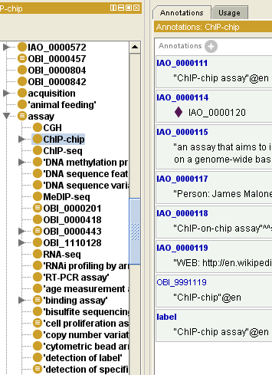
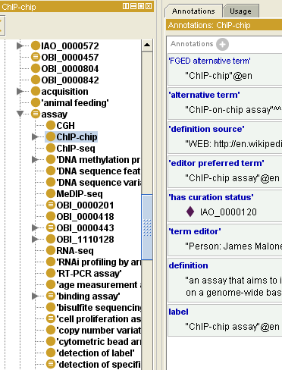
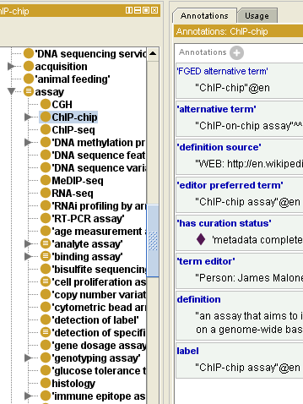
Question 1
OBI-FGED view, rendered by ‘FGED alternative term’
User-specified signature terms User-specified signature terms All terms
+ annotation properties

Slide 18
Acknowledgements
Bjoern Peters
Philippe Rocca-Serra
Alan Ruttenberg
Carlo Torniai
The OBI Consortium

